Slide 1

Jobs in Hands
Daniel Hodek
Tony Kim
Judao Zhong
Cheol-Yong Song
Skye Nguyen
https://www.glassdoor.ca/Photos/Jobseeker-On-Board-Office-Photos-IMG2331629.htm

Slide 2
Agenda
Problems address
& Solution
Market Approach
Financial Plan
Implementation

Slide 3

Problem Address
Many job search engines
Duplicate job postings
Manually scan key words in job descriptions for resume
Time consuming
Inefficient resumes
https://www.glassdoor.com/blog/5-tips-noticed-job-seeker/

Slide 4
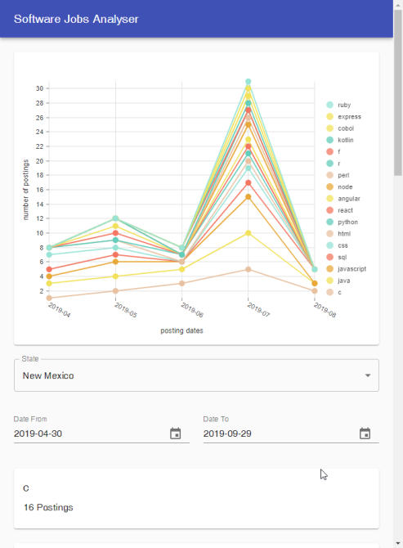
Solution
A Web-based Application for collecting and analyzing job-postings from different online sources
Free service for searching summary information
Advanced features with job insights, job trends, key power words
Monthly workshops

Slide 5

Market Approach
Target people in 18 – 30 age
Marketing Channel:
Job fairs
Student Associate at Universities
E-commerce Advertising
https://kingswayemployment.ca/employee/

Slide 6
Financial Plan – Break-Even Analysis
Expense | Estimated Cost
Administration | $26,000
Staff Salary | $250,000
Marketing | $24,000
Total | $300,000
Revenue | Unit price
Memberships | $20/month
Workshop register | $20/month
1250 users in the 1st year

Slide 7
Financial Plan
✓
500 monthly visits in the 1st year
✓
1000 users in the 1st year
✓
200 registers in monthly workshop in the 1st year
✓
Collaborate with five employment-related search engine for job listings

Slide 8
Implementation
Job Search Engines
JSON files
mLab Database
Prediction
& Automation
Self-service Reports
Back-End

Slide 9
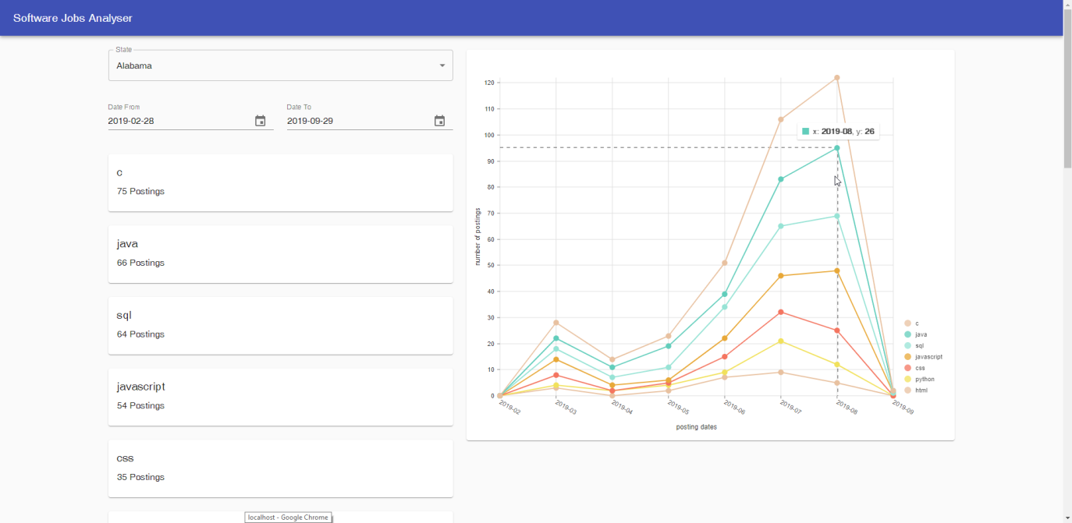
Implementation

Slide 10
Thank you for your attention!

